Slide 1

Project Guide:
Mr. Srinivasa A H,
Assistant Professor,
Dept. of CSE,
Dr. AIT
Presented By:
Name: Kumar Vedant,
USN: 1DA19CS078,
Dept. of CSE,
Dr. AIT

Slide 2

Project Presentation
Topic : Self Driving Car

Slide 3
Table of contents
01
The Project
03
Project Goals
02
Requirements
04
Project Stages

Slide 4
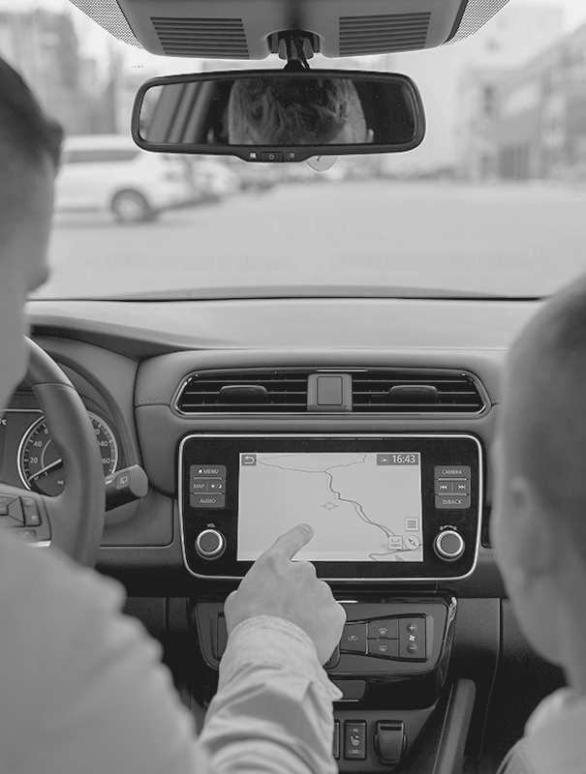
01
The
Project

Slide 5
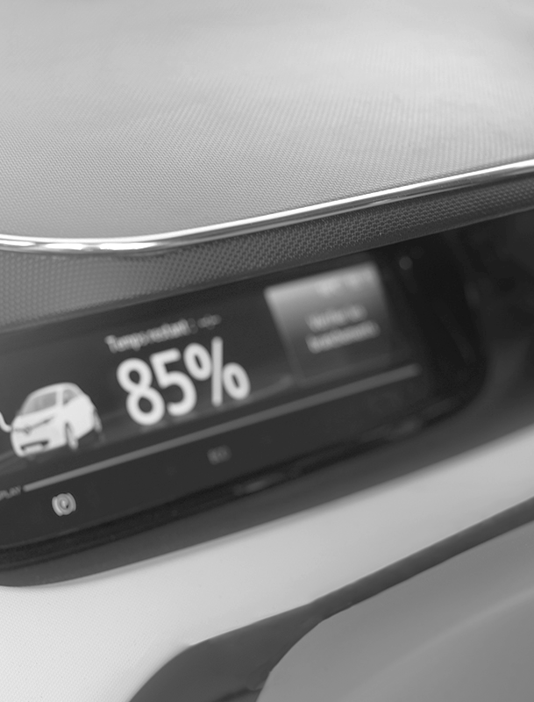
About the Project
Self-driving cars have rapidly become one of the most transformative technologies to emerge. Fuelled by deep learning algorithms, they are continuously driving our society forward and creating new opportunities in the mobility sector.

Slide 6
Why self-driving?
Vehicle Protection
Accident Reduction

Slide 7
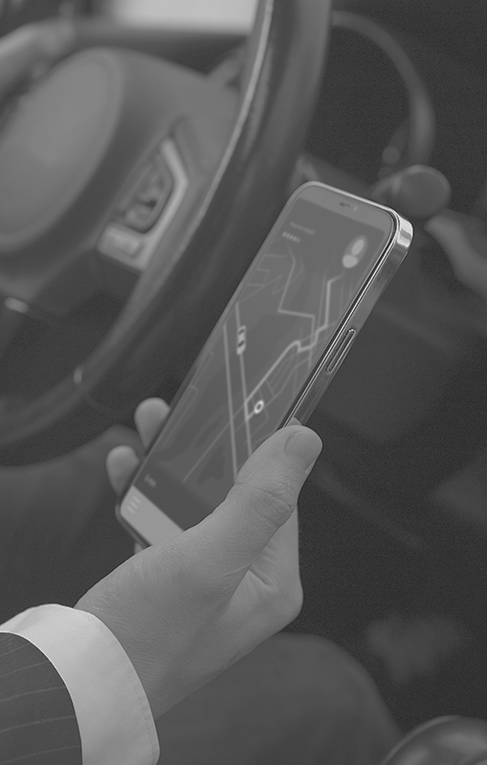
02
Major Requirements

Slide 8
Major Requirements
NumPy
OpenCV
Keras
NumPy is the fundamental package for scientific computing in python.
OpenCV provides a real-time optimized Computer Vision library, tools and hardware.
Keras is deep learning API written in python running on top of the machine learning platform Tensorflow.

Slide 9
Project Goals
Goal 1
Goal 2
Goal 3
Goal 4
To identify lane lines for a self driving car.
Train CNN to identify between various traffic signs.
Train Deep Neural Networks to fit complex datasets.
Build and train a fully functional self driving car.

Slide 10
Project Stages
24%
57%
80%
Stage 1
Stage 2
Stage 3
Computer Vision
Finding Lanes
Classifying Road Symbols
Behavioural
Cloning

Slide 11
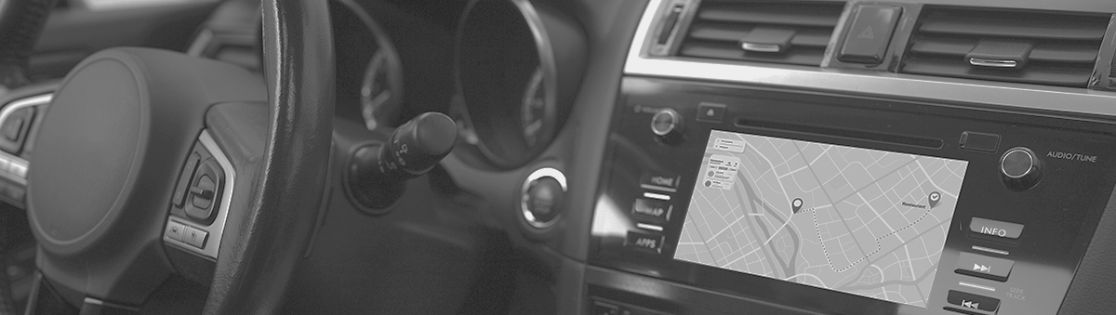
THANKS!
“Everything that can be automated will be automated”
—Robert Canon

